Slide 1
人工智能系统 System for AI 强化学习系统 System for Reinforcement Learning

Slide 2
1) 强化学习的基本概念 2) 强化学习中存在的系统的挑战 3) 当前的强化学习平台 4) 案例研究 : Ray & RLlib 5) 总结和思考 6) 参考资料
目录
RL algorithm (e.g. DQN/policy gradient/A3C/DDPG/TD3/SAC/)
RL abstraction & concept
Storage( e.g. redis)
Communicator(e.g. ray/mpi/RPC)
Scheduler
Local machines
Cluster or remote machines

Slide 3


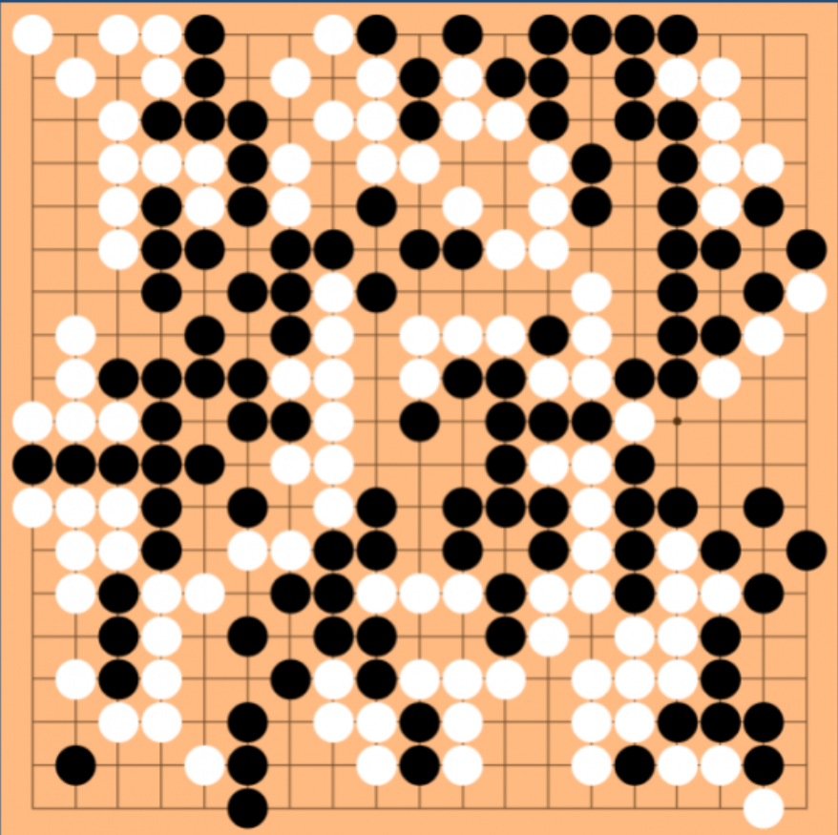

真实世界的问题: 在不确定的情况下做正确的序列选择
路径规划
驾驶
打游戏
人类的进化
…

Slide 4


强化学习
Training signal θ
state & reward
Real world environment
Agent
action
simulator
history info
Explore the world (explore)
Use experience to guide future decisions (exploit)

Slide 5
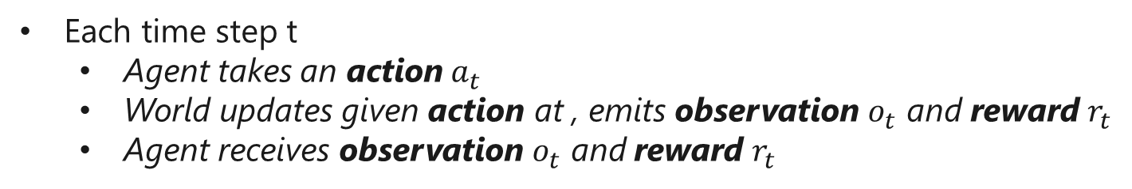
强化学习
Training signal θ
observation & reward
Real world environment
Agent
action
simulator
history info
Each time step t
Agent takes an action${ a}_{t}$
World updates given action at , emits observation $o_{t}$ and reward $r_{t}$
Agent receives observation $o_{t}$ and reward $r_{t}$

Slide 6
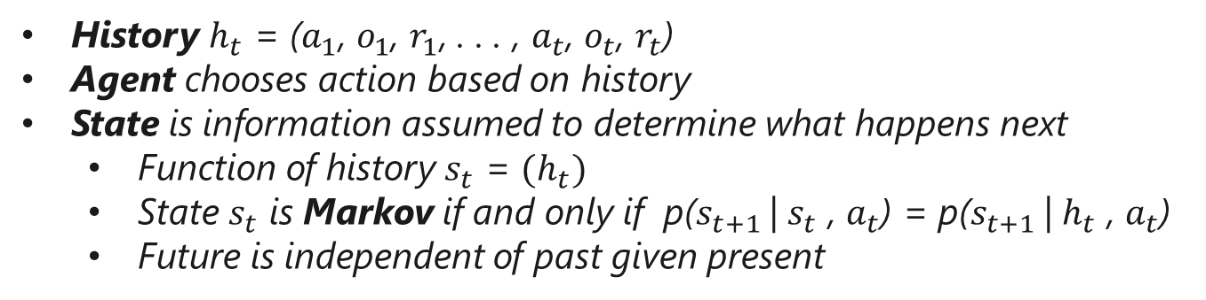
强化学习
Training signal θ
observation & reward
Real world environment
Agent
action
simulator
history info
History $h_{t}$ = ($a_{1}$, $o_{1}$, $r_{1}$, . . . , $a_{t}$, $o_{t}$, $r_{t}$)
Agent chooses action based on history
State is information assumed to determine what happens next
Function of history $s_{t}$ = $(h_{t})$
State $s_{t}$ is Markov if and only if p($s_{t+1}$| $s_{t}$ , $a_{t}$) = p($s_{t+1}$| $h_{t}$ , $a_{t}$)
Future is independent of past given present

Slide 7
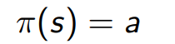
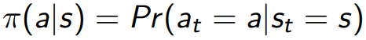
强化学习
Goal select actions to maximize total expected future reward
balancing immediate & long-term rewards
Policy π determines how the agent chooses actions
Deterministic policy
Stochastic policy
Value function expected discounted sum of future rewards under a policy π

Slide 8
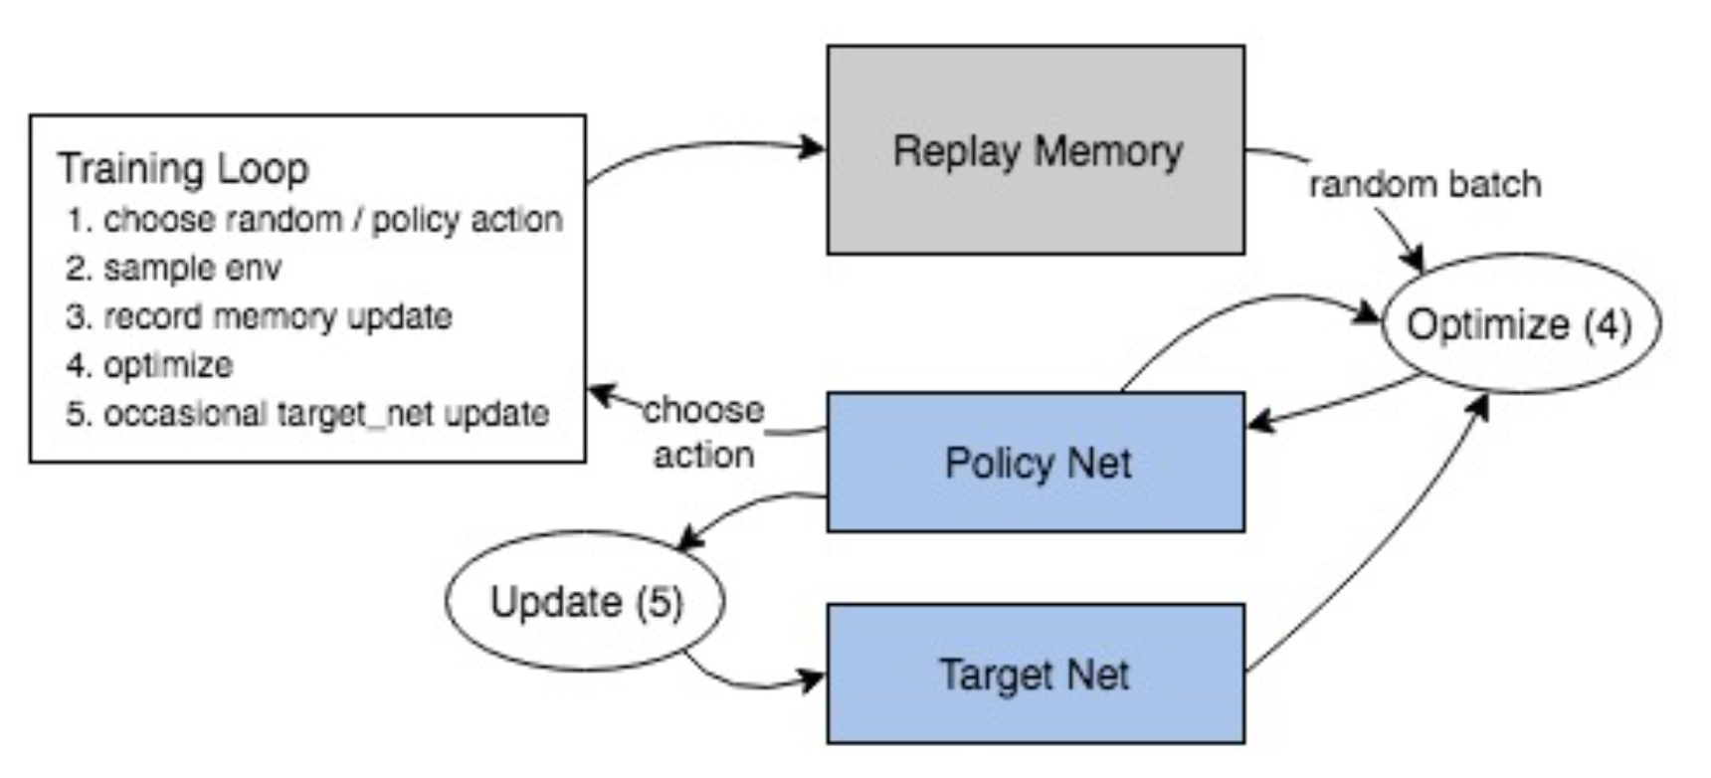
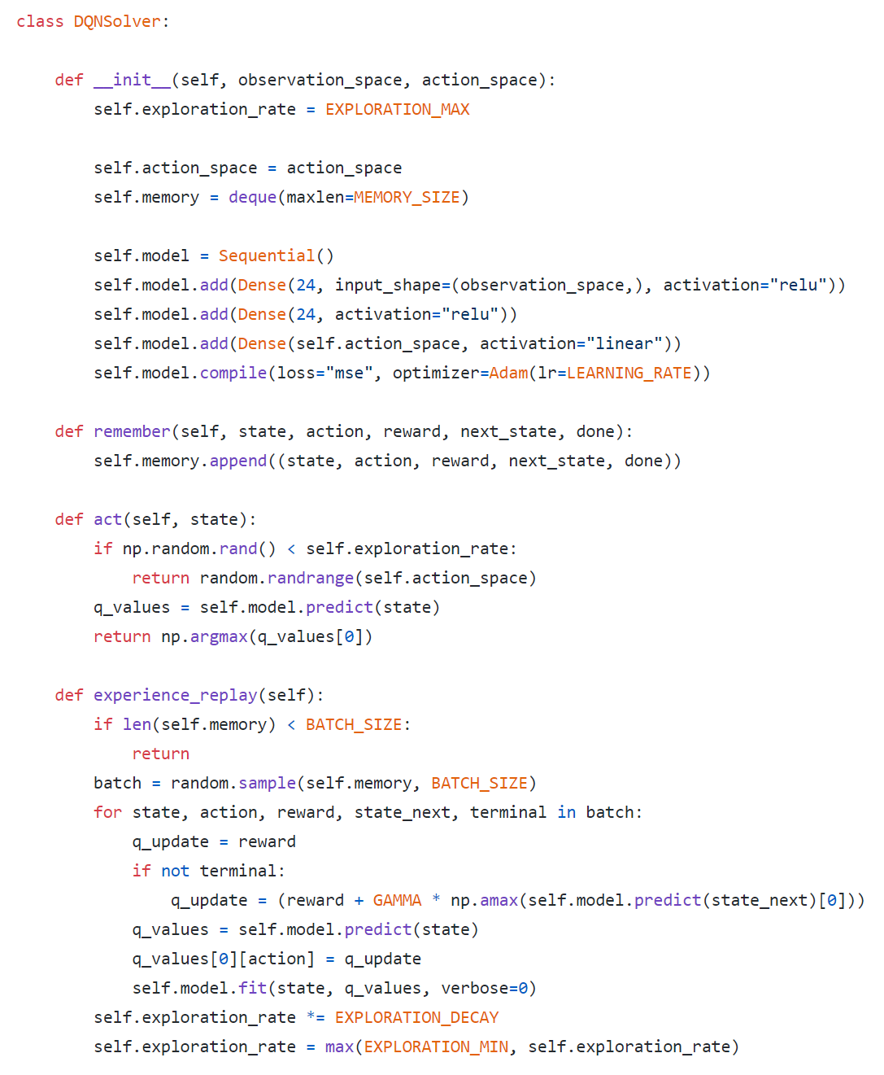
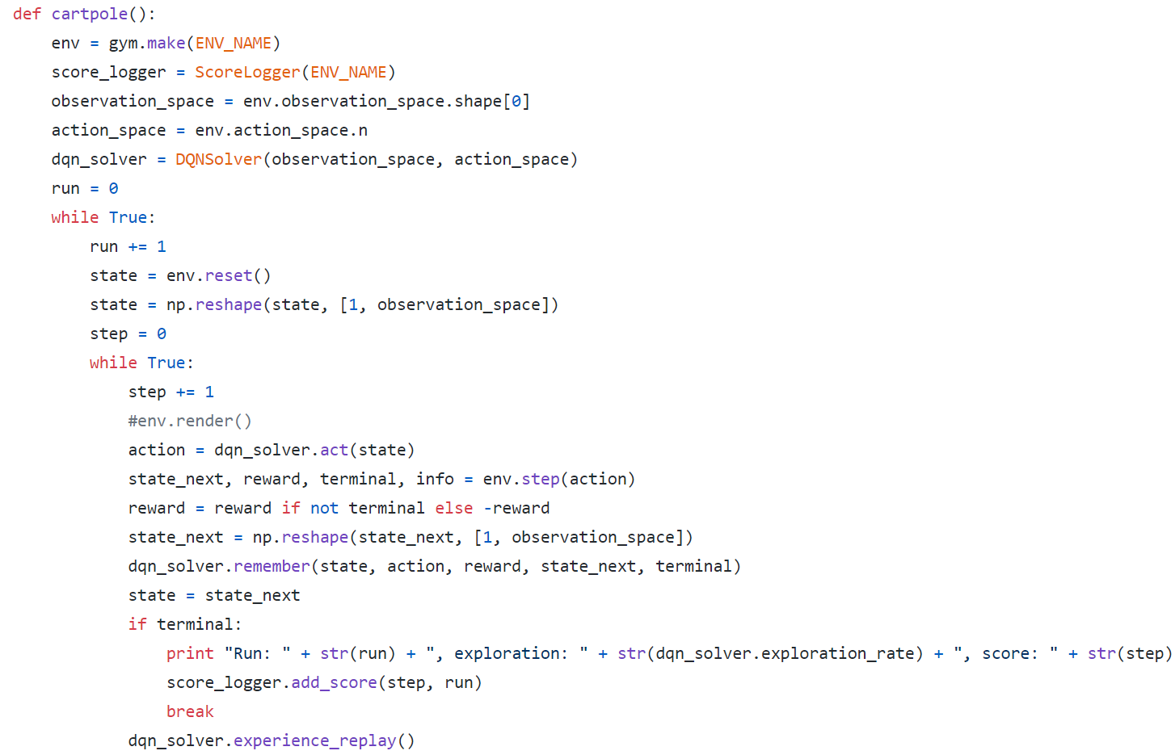
单机异步的DQN的例子
initialize env
Policy model
initialize policy
training loop
Policy inference
Rollout data
Policy update
Update policy

Slide 9
强化学习和机器学习有什么差别？ 强化学习系统面临什么和机器学习系统不一样的挑战？

Slide 10
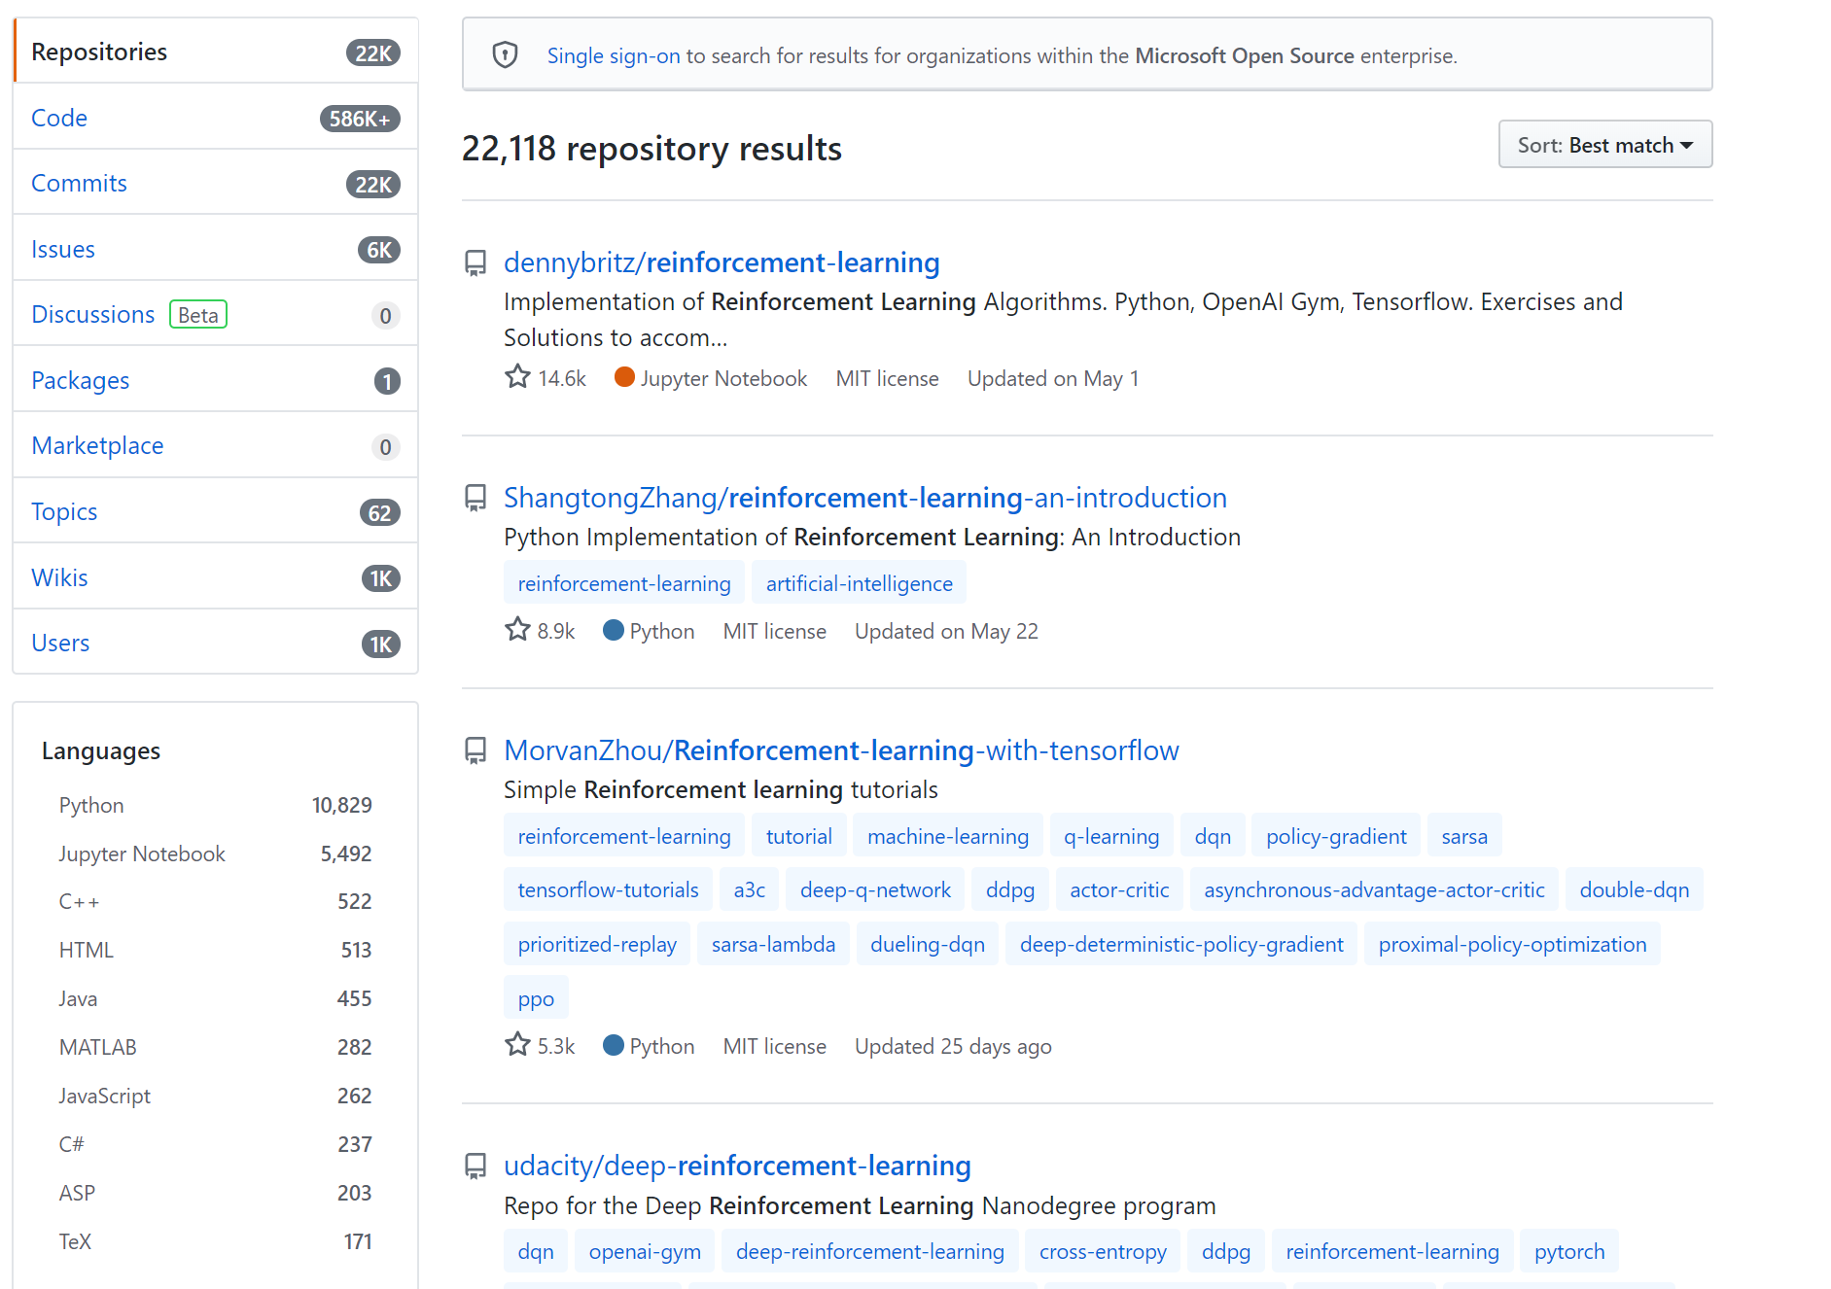
大量难以复用的强化学习代码库

Slide 11

为什么不能复用这些存在的代码库呢？

Slide 12
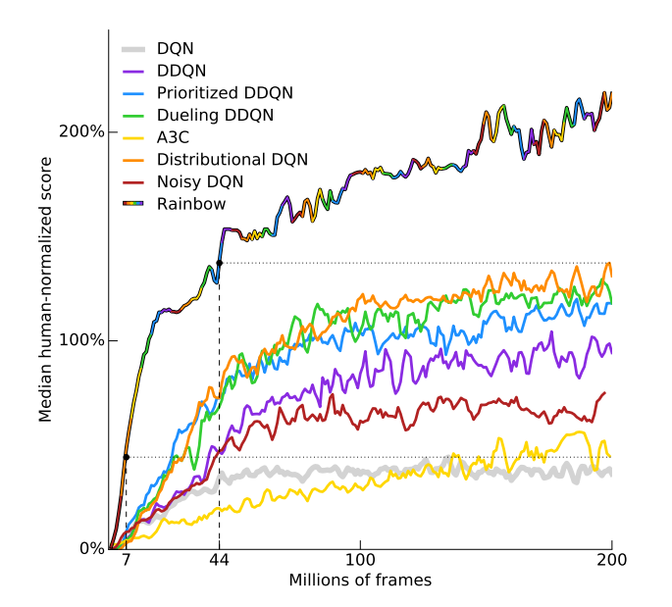
算法上的一点差别可能会极大影响结果
Figure 2. 6 tricks in DQN will performs different performance from rainbow paper.

Slide 13
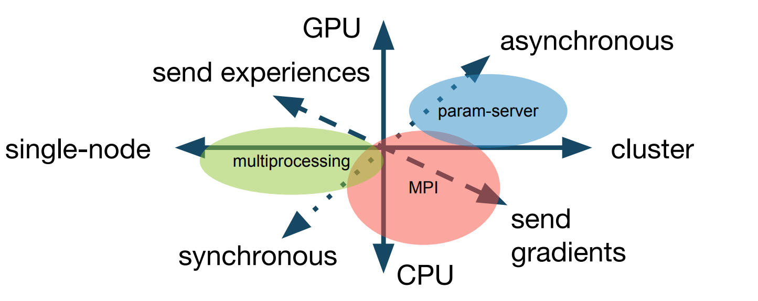
强化学习的执行策略多种多样，底层可使用的通信框架各式各样

Slide 14
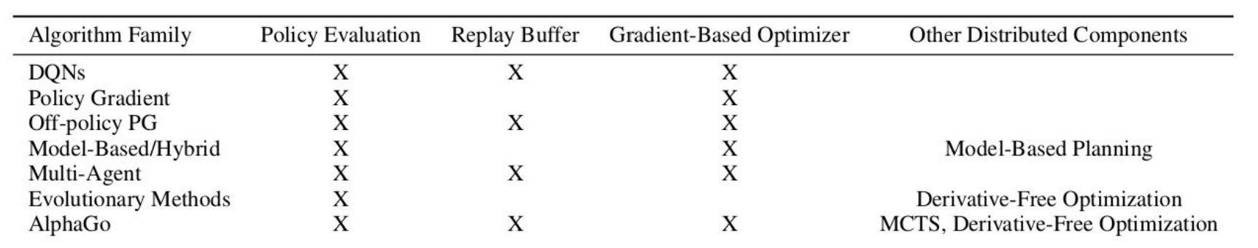
不同的强化学习算法结构差异很大

Slide 15
强化学习算法和分布式架构互相影响
解决新架构产生收敛问题
新算法
新架构
让算法跑得更快

Slide 16
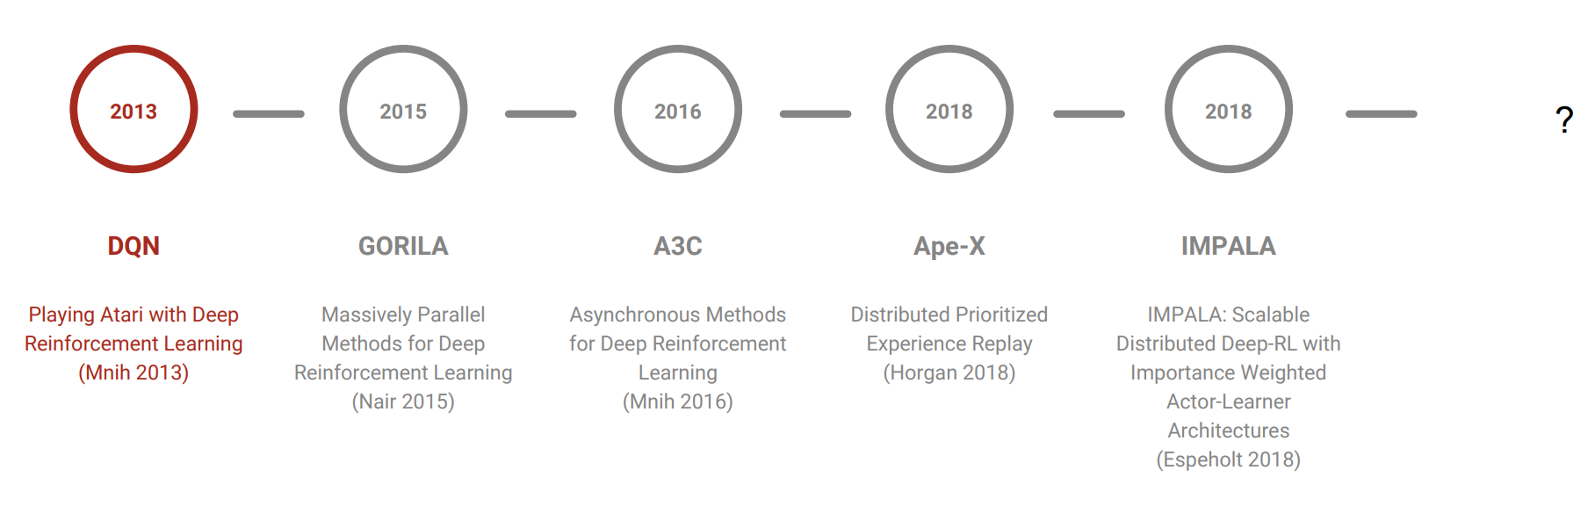
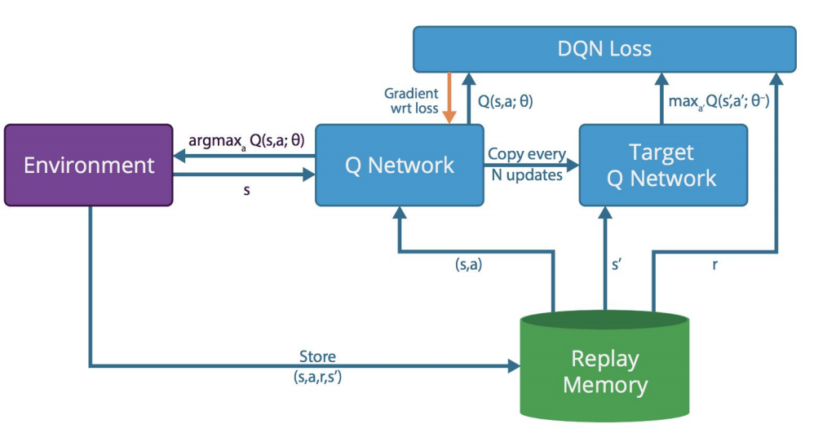
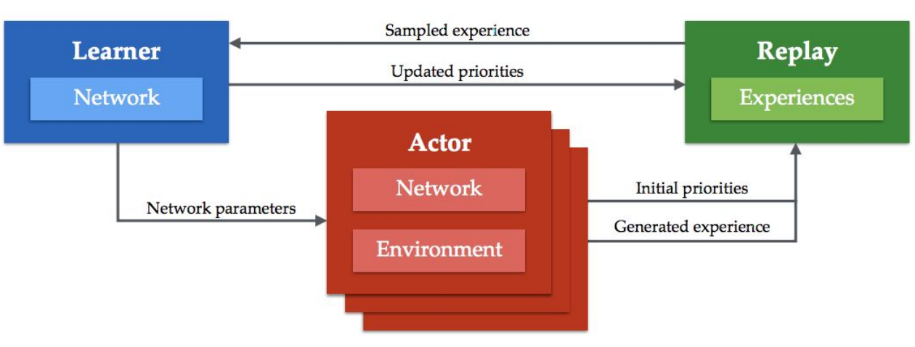
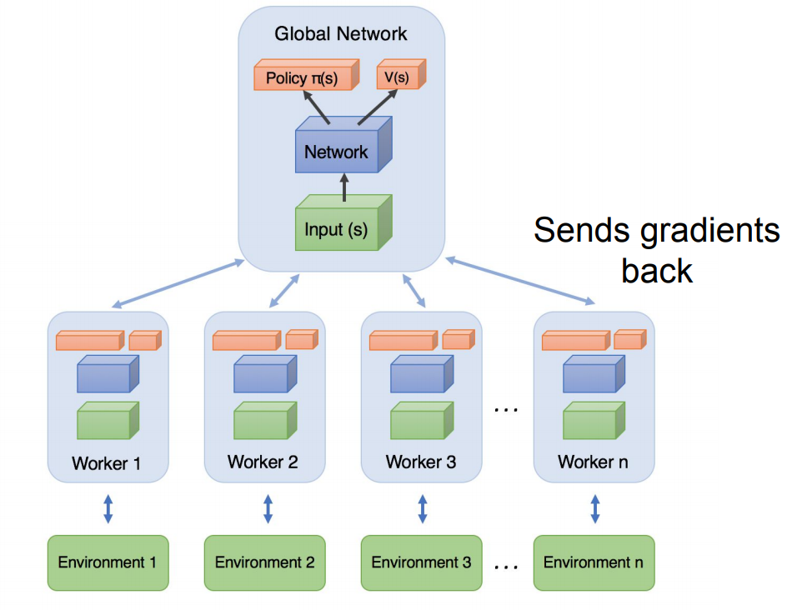
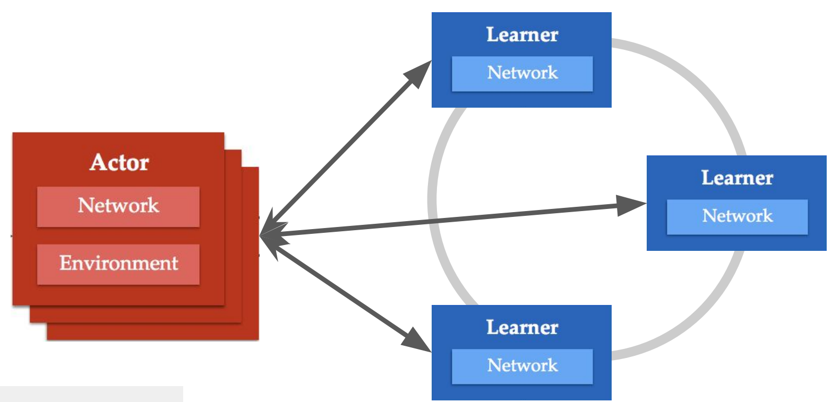
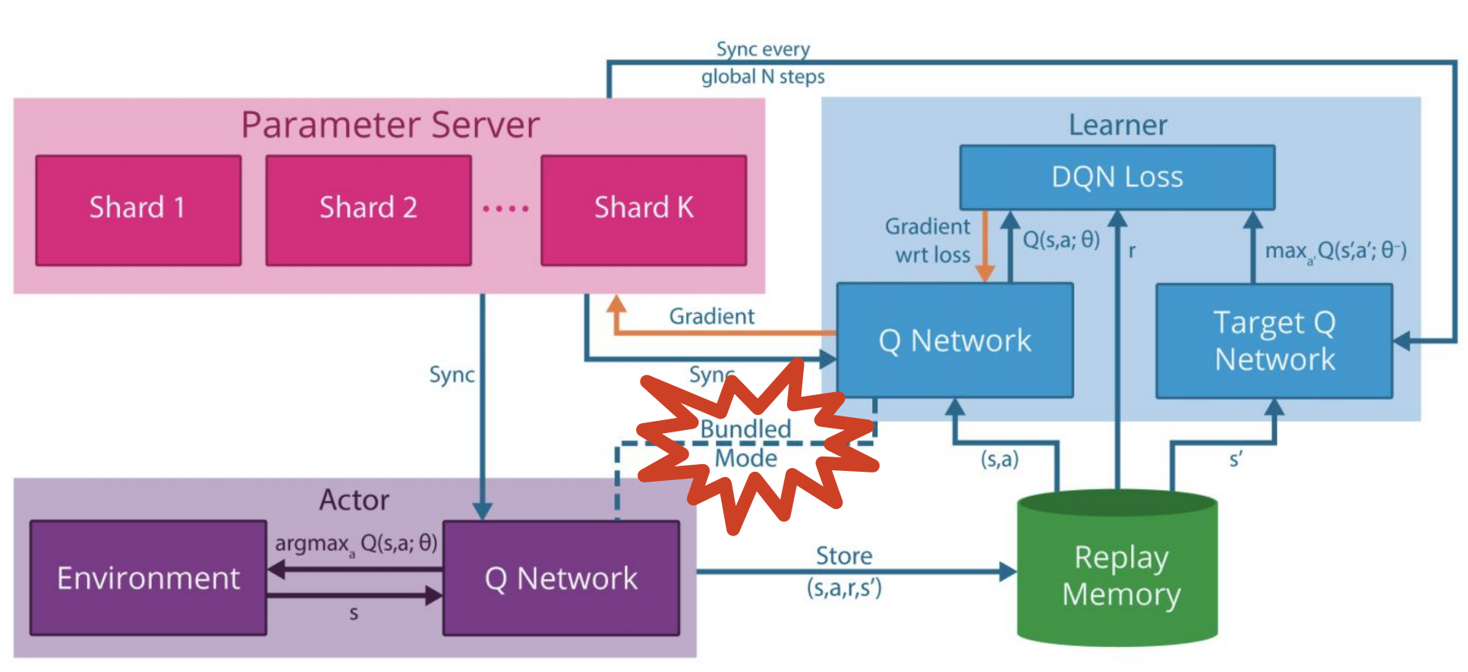
强化学习算法和分布式架构互相影响

Slide 17
小结
大量难以复用的强化学习代码
可扩展性的强化学习框架
具有良好的强化学习算法的抽象接口
可以跨深度学习平台使用（e.g. tensorflow/pytorch）
可以支持各种物理执行模式（e.g. GPU/CPU vs Sync/Async）
支持不同的分布式架构

Slide 18
强化学习需要实时采集数据
training data
ML model
一般的机器学习
Training signal θ
observation & reward
Real world environment
强化学习
循环地采集数据去学习
可以自己决定采集什么数据
Agent
action
simulator
history info

Slide 19
采集数据的效率是收敛的关键！
可能面临的问题
和环境交互的效率低下，环境返回的结果时间较长
分布式rollout数据可行，但代码难写
支持复杂环境的并发采集
提供简单的分布式代码的编程方式

Slide 20
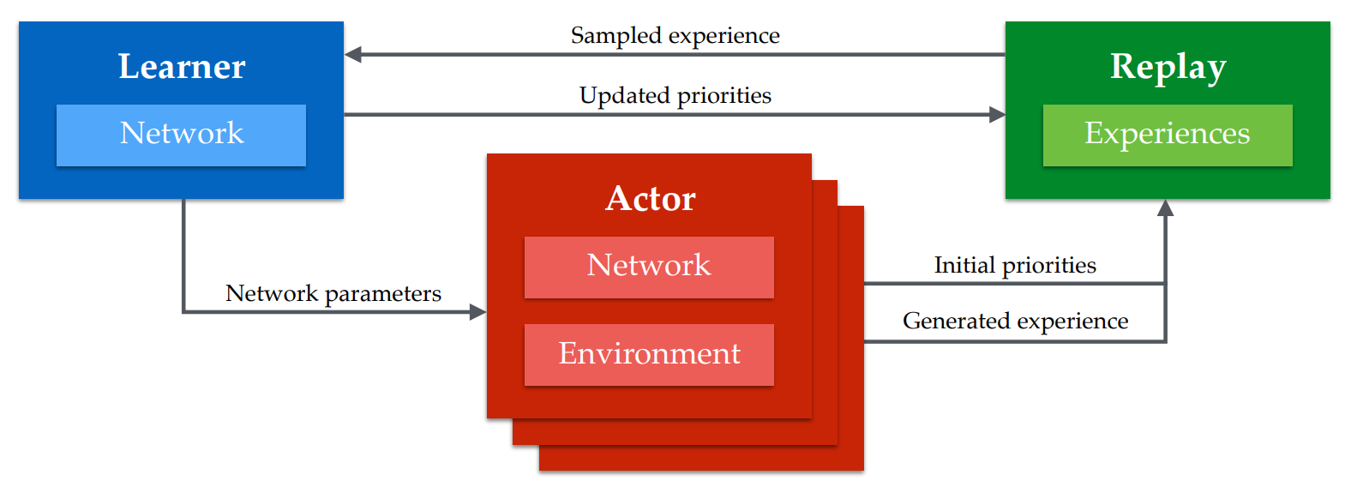
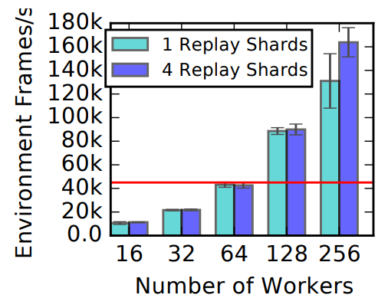
Apex框架让worker分布式地rollout data
Figure1. Apex architecture, multiply actors to rollout data in their own environment.

Slide 21
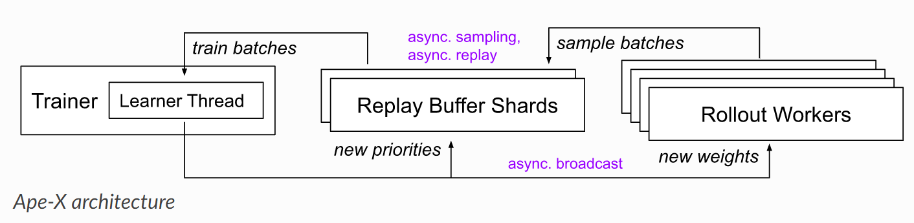
强化学习训练需要切换context
同时可能需要传输大量的数据
GPU
CPU
Figure 3. Context switch in Apex architecture

Slide 22
强化学习训练需要切换context
需要在不同的context（GPU/CPU）间不停的切换
同时需要传输大量的数据
支持高性能的通信框架
优化数据的预处理
优化数据的传输

Slide 23
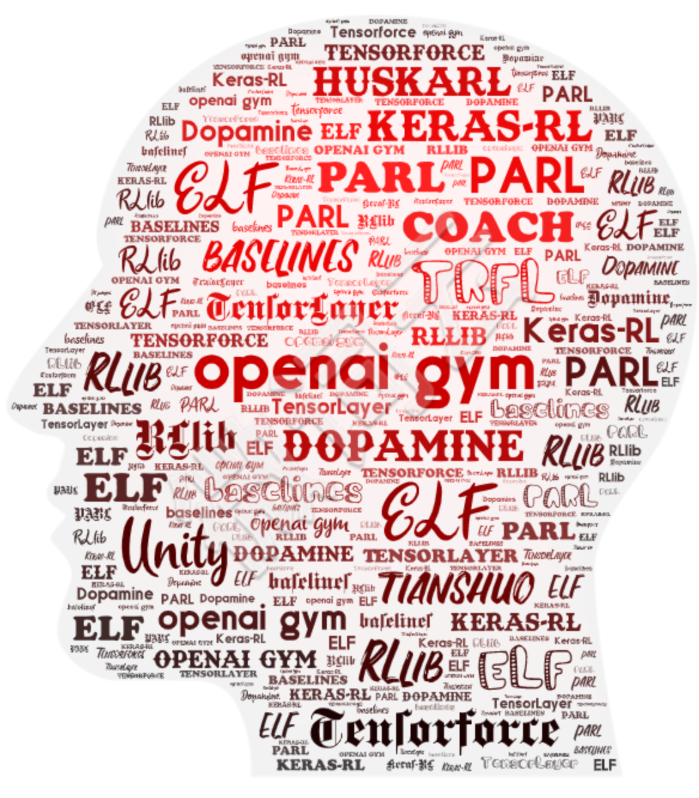

当前的强化学习平台
此照片，作者: 未知作者，许可证: CC BY-NC

Slide 24
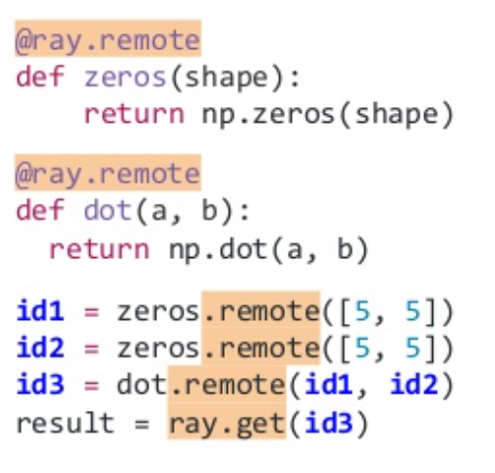
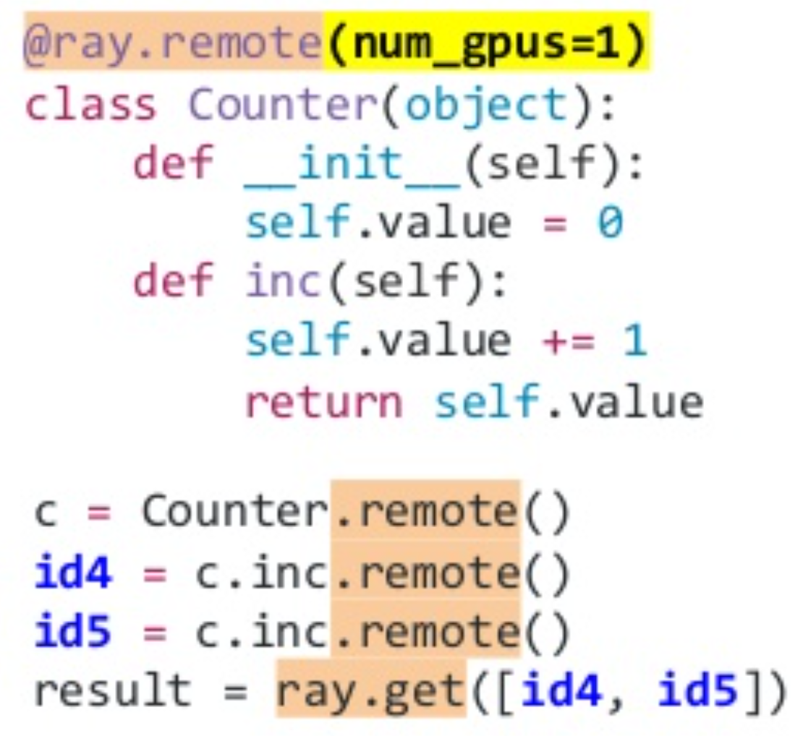
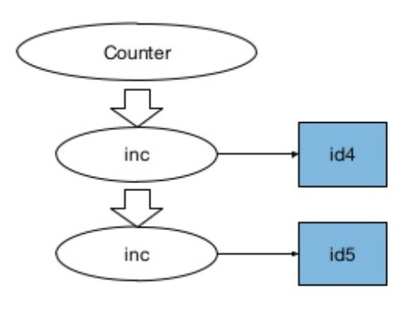
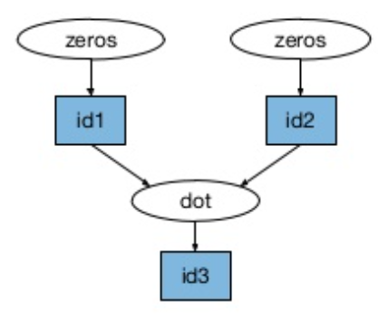
案例研究: Ray and RLlib
Ray is a fast and simple framework for building and running distributed applications.
Ray provide a task parallel API
Ray provide an actor API
Github repo: https://github.com/ray-project/ray

Slide 25
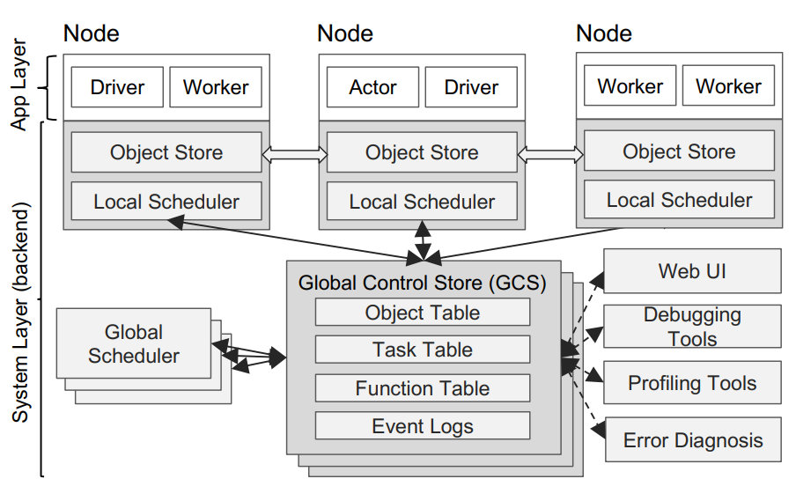
案例研究: Ray and RLlib
Ray is a fast and simple framework for building and running distributed applications.
App Layer
Driver - A process executing the user program
Worker - A stateless process that executes remote functions invoked by a driver
Actor - A stateful process that executes
System Layer
Global Control Store(GCS)
A key-value store with pub-sub functionality
Distributed scheduler
Submitted first to local scheduler
Global scheduler considers each node’s load and task’s constraints to make scheduling decisions
Distributed object store
In-memory distributed storage to store the inputs/outputs, or stateless computation.
Implement the object store via shared memory
Use Apache Arrow as data formats
• Faster than Python multiprocessing on a single node
• Competitive with MPI in many workloads

Slide 26
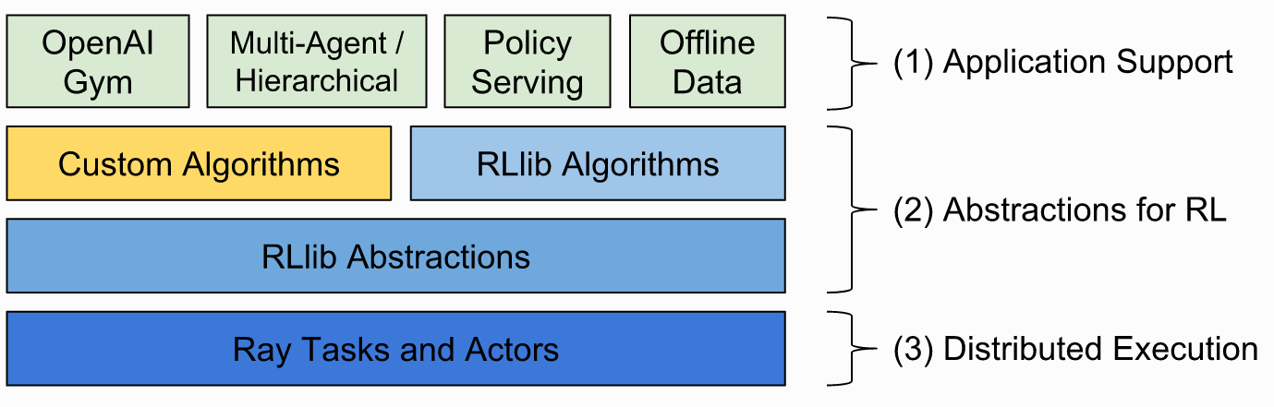
案例研究: Ray and RLlib
RLlib is an open-source library for reinforcement learning that offers both high scalability and a unified API for a variety of applications.
RLlib
Ray
Github repo: https://github.com/ray-project/ray/tree/master/rllib

Slide 27
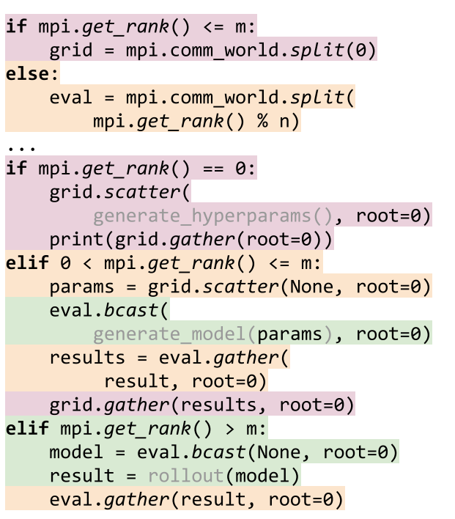
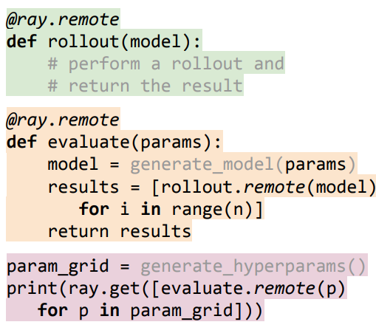
友好的分布式编程接口
Ray’s distributed scheduler is a natural fit for the hierarchical control model, as nested computation can be implemented in Ray with no central task scheduling bottleneck.
a. Distributed control in MPI
b. Hierarchical control in ray.

Slide 28
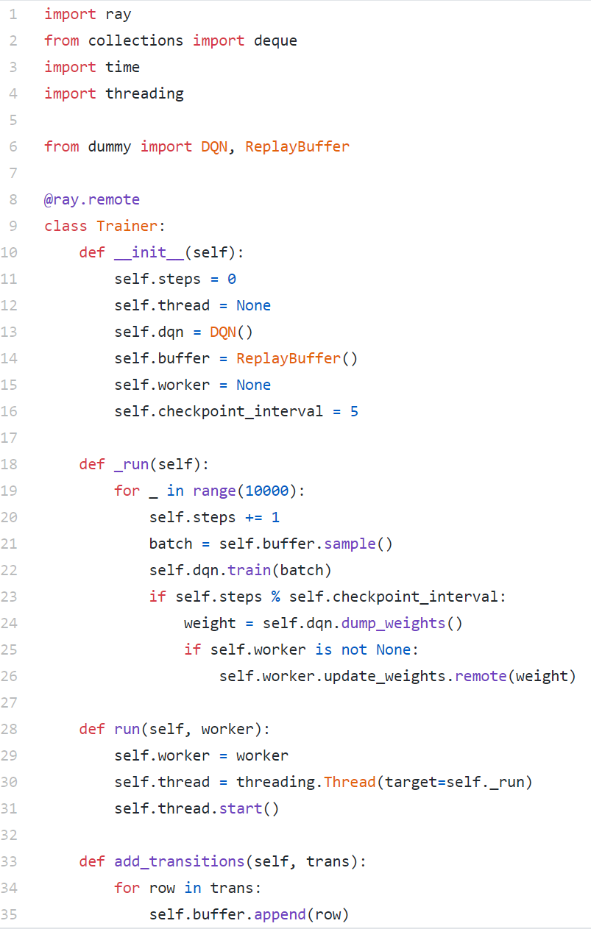
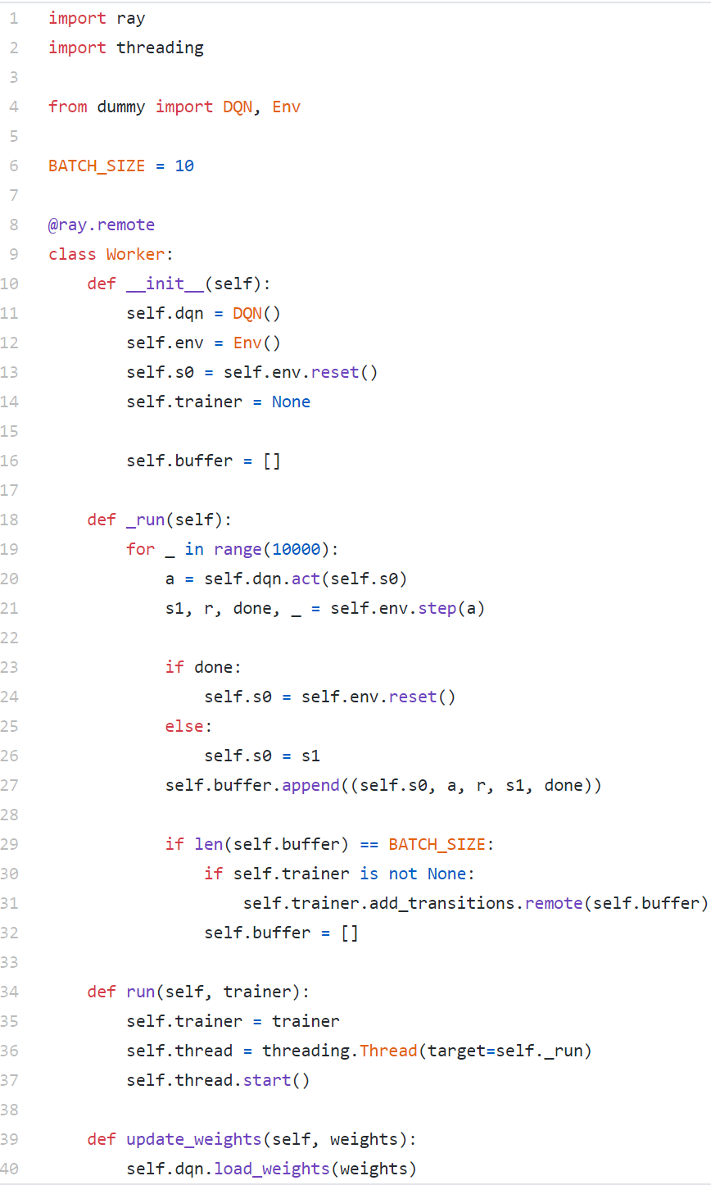
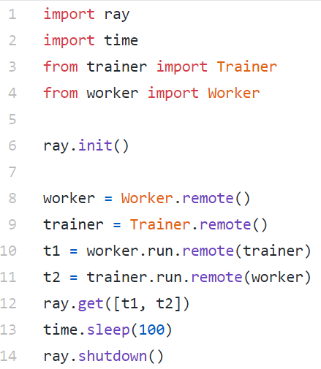
基于Ray的简单的异步DQN的例子
Actors
Run script
Trainer
Remote decorator for run in remote
Init ray
Execute the trainer and actor in remote
Start thread for async training

Slide 29
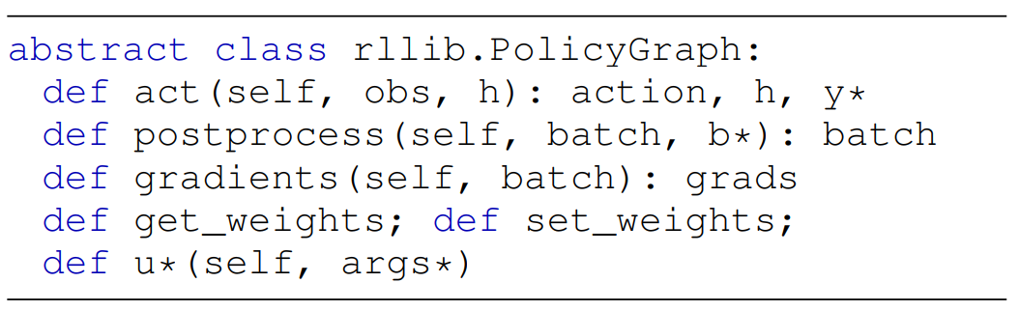
为了容易使用而设计的模块化算法
Training signal θ
observation & reward
Real world environment
Agent
action
simulator
history info
Agent
Policy Graph
Policy Model
Policy Optimizer

Slide 30
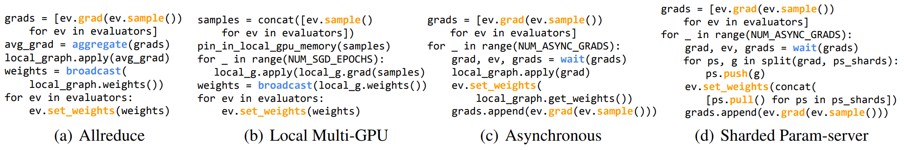
为了容易使用而设计的模块化算法
Agent
Policy Graph
The policy optimizer is responsible for the performance-critical tasks of distributed sampling, parameter updates, and managing replay buffers.
Policy Model
Policy Optimizer
Figure 4. Pseudocode for four RLlib policy optimizer step methods. Each step() operates over a local policy graph and array of remote evaluator replicas.

Slide 31
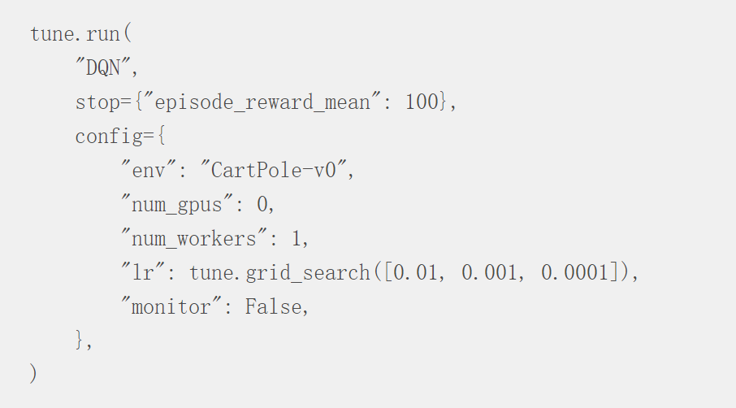
支持的强化学习算法
High throughput architectures
Distributed Prioritized Experience Replay(Ape-X-DQN, Ape-X-DDPG)
Importance Weighted Actor-Learner Architecture(IMPALA)
Gradient-based
Advantage Actor-Critic(A2C, A3C)
Deep Deterministic Policy Gradients(DDPG, TD3)
Deep Q Networks(DQN, Rainbow)
Policy Gradients
Proximal Policy Optimization(PPO, APPO)
Soft Actor-Critic(SAC)
Single player AlphaZero
Derivative-free
Augment Random Search(ARS)
Evolution Strategies
Multi-agent
Monotonic Value Function Factorization(QMIX, VDN, IQN)
MADDPG

Slide 32
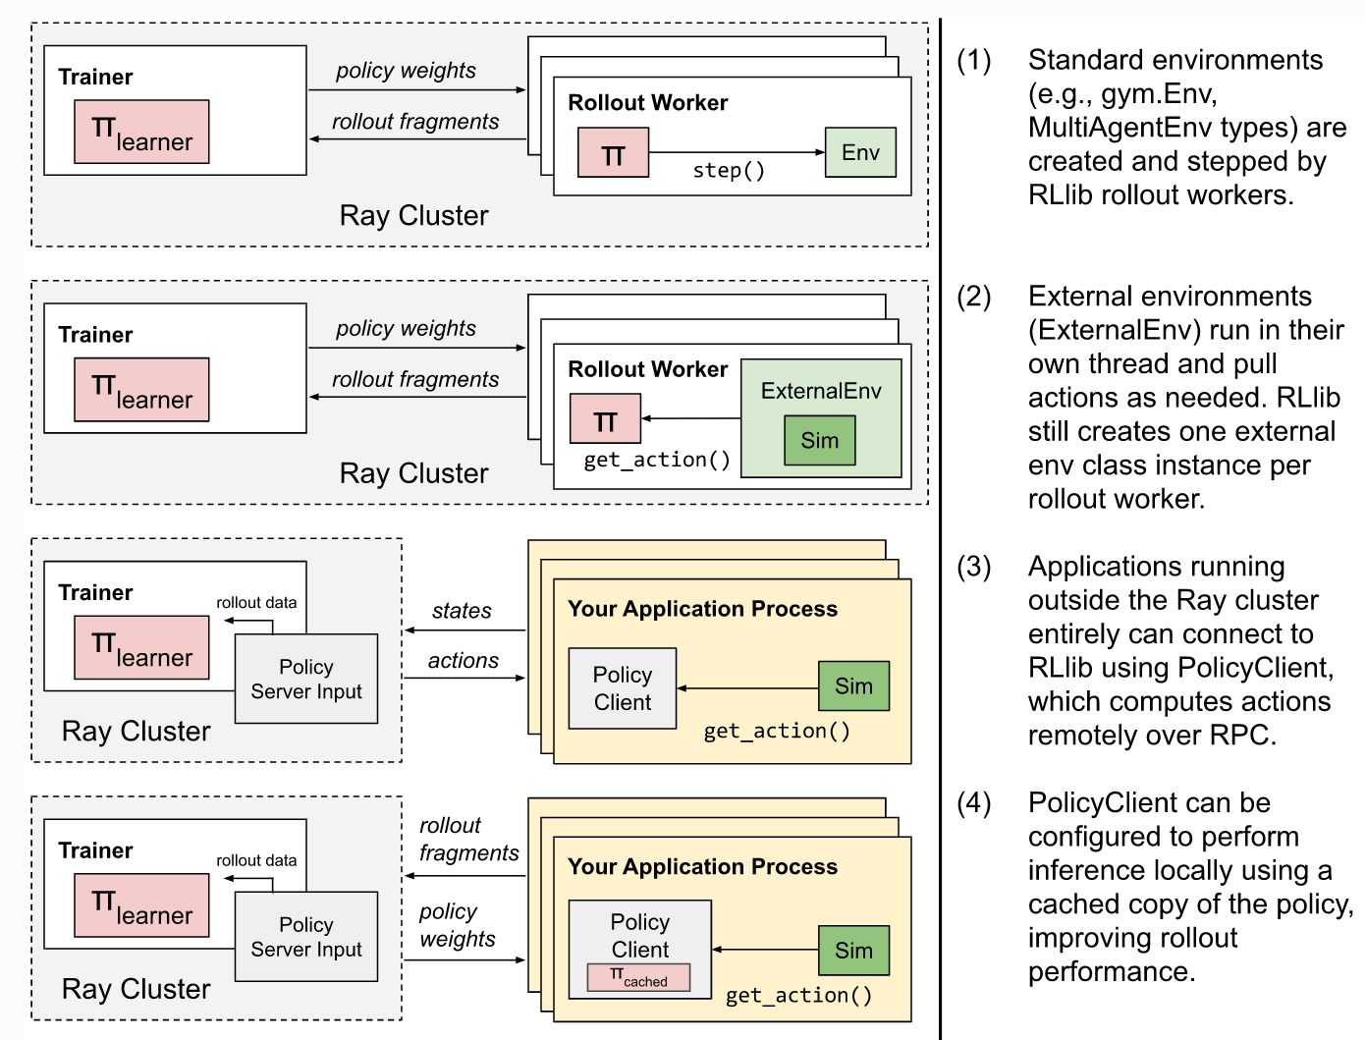
支持的复杂的环境

Slide 33
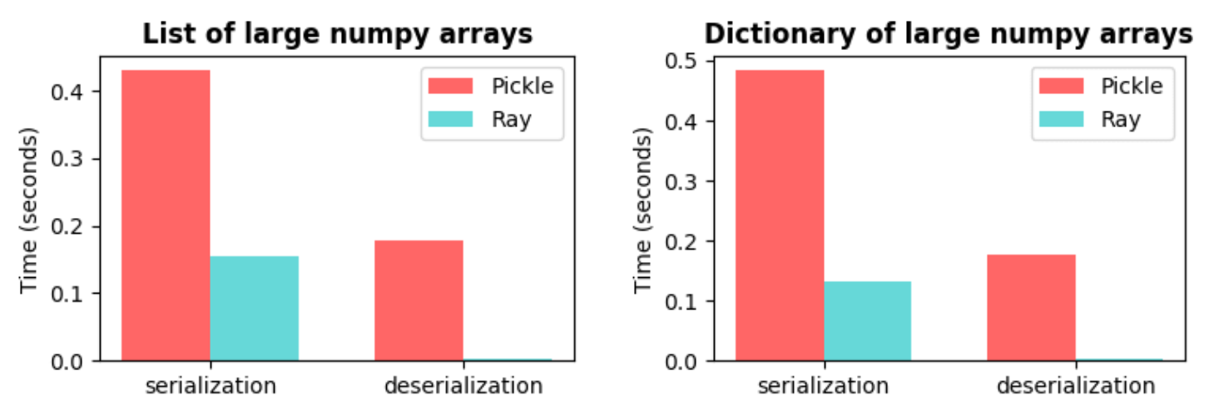
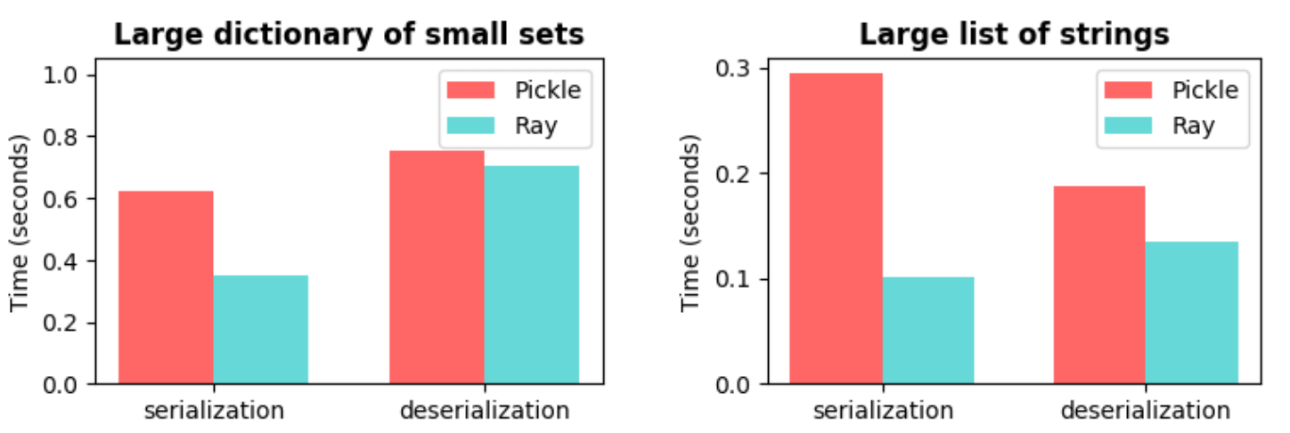
快速的序列化和反序列话
Serialization and deserialization are bottlenecks in parallel and distributed computing, especially in machine learning applications with large objects and large quantities of data.
Goals
Very efficient with large numerical data (e.g. Numpy arrays and Pandas dataframes)
As fast as Pickle for general Python types
Compatible with shared memory (allowing multiple processes to use the same data without copying it)
Deserialization should be extremely fast (e.g. streaming)
language independent
Notes:
The fact that the Ray bars for deserialization are barely visible is not a mistake. This is a consequence of the support for zero-copy reads (the savings largely come from the lack of memory movement).
Note that the biggest wins are with deserialization. The speedups here are multiple orders of magnitude and get better as the NumPy arrays get larger (thanks to design goals 1, 3, and 4). Making deserialization fast is important for two reasons. First, an object may be serialized once and then deserialized many times (e.g., an object that is broadcast to all workers). Second, a common pattern is for many objects to be serialized in parallel and then aggregated and deserialized one at a time on a single worker making deserialization the bottleneck.

Slide 34
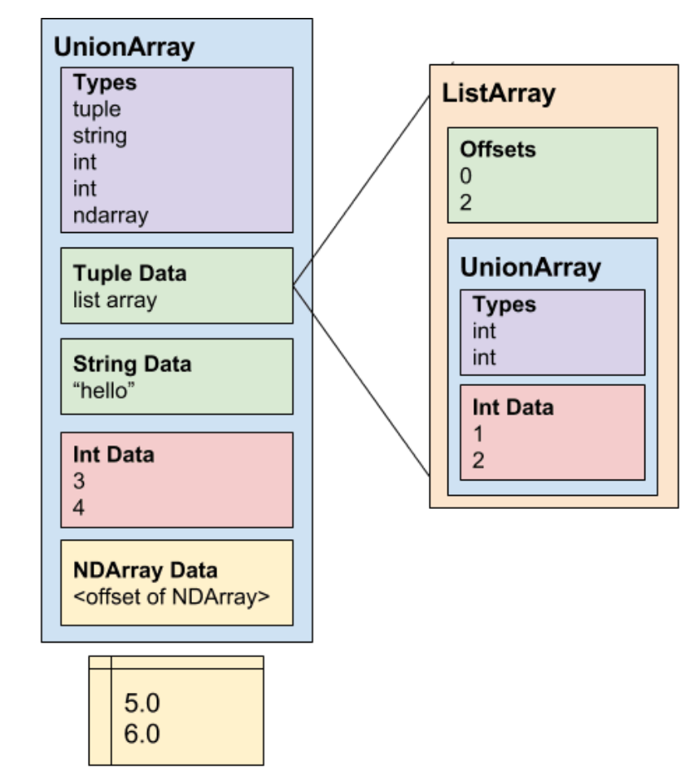
快速的序列化和反序列话
Making deserialization fast is important.
An object may be serialized once and then deserialized many times
A common pattern is for many objects to be serialized in parallel and then aggregated and deserialized one at a time on a single worker making deserialization the bottleneck
Deserialization is fast and barely visible
Using only the schema, can compute the offsets of each value in the data blob without scanning through the data blob (unlike Pickle, this is what enables fast deserialization)
Avoid copying or otherwise converting large arrays and other values during deserialization(the savings largely come from the lack of memory movement)

Slide 35
不同通信框架的速度评测
The speed of transferring 1GB data.

Slide 36
RLlib的小总结
优雅而简单的分布式编程语言
容错和高并发的分布式框架
通用的强化学习接口
为python对象优化的高效通信框架
在Rllib上实现一个新的RL算法需要多大的代价呢？

Slide 37
强化学习的其他挑战
可复现性 (e.g. SURREAL)
可解释性
从少量的数据中学习
安全限制
实时推理
…

Slide 38
参考资料
Ray: A Distributed Framework for Emerging AI Applications
RLlib: Abstractions for Distributed Reinforcement Learning
DISTRIBUTED PRIORITIZED EXPERIENCE REPLAY
Rainbow: Combining Improvements in Deep Reinforcement Learning
SEED RL: Scalable and Efficient Deep-RL with Accelerated Central Inference
IMPALA: Scalable Distributed Deep-RL with Importance Weighted Actor-Learner Architectures
Asynchronous Methods for Deep Reinforcement Learning
SURREAL: Open-Source Reinforcement Learning Framework and Robot Manipulation Benchmark
Challenges of Real-World Reinforcement Learning
Apache Arrow https://arrow.apache.org/
https://wesmckinney.com/blog/arrow-streaming-columnar/
Modin(speed up the pandas in ray) https://github.com/modin-project/modin
https://www.zhihu.com/question/377263715
https://www.slideshare.net/databricks/enabling-composition-in-distributed-reinforcement-learning-with-ray-rllib-with-eric-liang-and-richard-liaw
https://github.com/deepmind/reverb

